Slide 1
Radiology and the Kidney
Brian Cronin MD, FASN, FACP
March 13 2025

Slide 2
Disclosure
Some questions modified from ASN
KSAP
NephSAP

Slide 3
Case 1
57 yo female presents with right sided abdominal pain.
PMH: Solitary kidney s/p left nephrectomy at age of 11 for dysfunctional kidney incidentally found on imaging done for trauma.
PE: BP 131/65 HR 67 NAD, abdomen soft, nontender no palpable masses, no edema
Cr 1.19 (eGFR 53), baseline 0.91, improved to 0.85 over 12 hrs with IVF
UA: SG 1.008, neg prot, 1+ blood, neg leukocyte, 2 RBC, 1 WBC per HPF
CT (w/o contrast): Moderate to severe right hydronephrosis with abrupt narrowing of the ureteropelvic junction.
What study is best to assess for obstruction?

Slide 4
Diuretic Renal Scan
A nuclear medicine renal scan involves imaging with a compound taken up by the kidney that is bound to a radioisotope. There are different compounds used that are bound to the radioisotope technetium:
MAG3: 99m dimercaptosuccinic acid
Most common compound used for renal scans
Rapid extraction by renal tubular cells. Higher extraction rate than DTPA.
Secretion is mainly by proximal tubules

Slide 5
Evaluation of Obstructive Uropathy: Diuretic (Furosemide) Renal Scan
Renal scanning is often used to assess if hydronephrosis is due to true functional obstruction as opposed to anatomic non-obstructive dilatation. Non obstructive hydronephrosis can be seen in vesicoureteral reflux, congenital malformations, or with a noncompliant bladder.
In these cases a diuretic (furosemide) renal scan is performed.
The radionuclide (typically bound to MAG3) is injected.
Renal excretion of the radiotracer is assessed.
Diuretic (furosemide) is administered.
If radiotracer excretion increases (normal half life < 9.8 minutes), indicative of non obstructive dilatation.
If radiotracer excretion unaffected or minimally effective (prolonged half life > 20 minutes) consistent with obstructive uropathy
NSAIDS should not be administered as affect radionuclide excretion

Slide 6
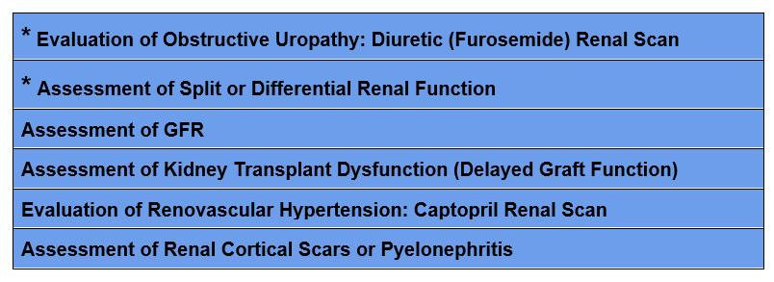
Indications for Renal Scan
* Common Uses

Slide 7
Case 2
58 year old male referred for stage 3 CKD.
PMH: HTN, DM, hyperlipidemia
SH: 10 pack year history of smoking, quit 25 years ago
Medications: Lisinopril, dapagliflozin, rosuvastatin, aspirin
PE: BP 146/84 HR 72, NAD. No edema
Labs: C4 1.54 (eGFR 52), UA: trace protein; neg blood; neg leukocyte, UACR 240 mg/g
US: Normal size and echogenicity. 3 cm cyst with complex features in the right upper pole
What is the best study to assess the cyst?

Slide 8
CT Urogram
CT urogram: 3 phase CT with contrast
Non contrast phase
Nephrogenic phase
Excretory phase
Test of choice for urologic evaluation of hematuria
Contrast required to rule out renal malignancy
Benign lesions do not enhance
Renal cell carcinomas enhance
Oncocytomas and lipid poor angiomyolipomas (benign neoplasms) also enhance

Slide 9
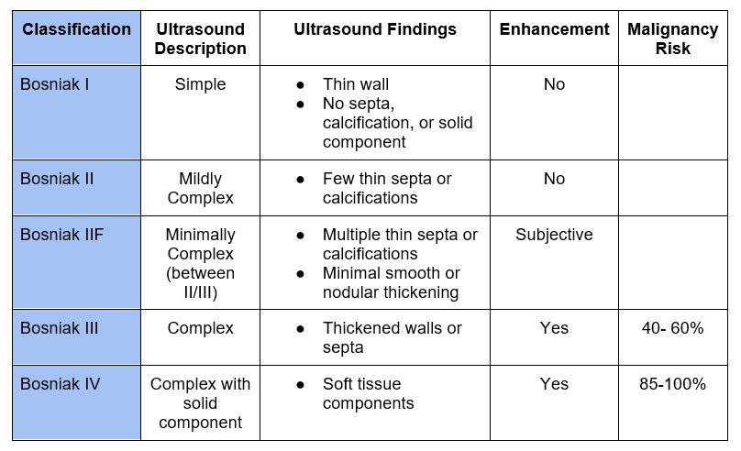
Renal Cyst Classification

Slide 10
Case 3
29 year old female with family history of ADPKD presents for routine physical. She asks if there is testing to determine if she has PKD.
ROS: Negative for hematuria or flank pain
PE: BP 108/74 HR 72 remainder normal
Cr 0.72, eGFR 116, UA: negative occult blood, protein, leukocyte
Can ultrasound rule out ADPKD?

Slide 11
ADPKD
Age | # of Cysts | PPV: Sensitivity:
15-29 | > 3 total | PPV: 100% Sensitivity: 69.5 - 94.3%
30-39 | > 3 total | PPV: 100% Sensitivity: 94.9 - 96.6%
40-59 | > 2 in each kidney | PPV: 100% Sensitivity: 88.8 - 92.6%

Slide 12
Case 4
70 yo male with HTN, CAD, hyperlipidemia and recent right total knee replacement presents with acute onset dyspnea and pleuritic chest pain. .
PE: BP 158/74; HR 108; 88% on RA mildly dyspneic, no murmurs, lungs CTA, neg edema
CXR: Mild atelectasis, cardiomegaly
Cr 1.84, eGFR 39 (at baseline)
Do you order CTA chest with contrast?

Slide 13
Contrast Nephropathy
Contrast Associated Acute Kidney Injury (CA-AKI): AKI that occurs after IV contrast.
Contrast Induced Acute Kidney Injury (CI-AKI): AKI that occurs because of contrast.

Slide 14
Contrast Nephropathy
Everything in medicine is a risk benefit ratio. The risk is either high, low, or theoretically possible. The benefit is either high, low, or theoretically possible.
If the benefit of contrast is extremely high, it may make sense to give the contrast even with CKD 4 or 5 (eGFR < 30) or AKI (see below).
If the benefit of contrast is very low, it may make sense to not give contrast for lesser degrees of CKD (ie. CKD stage 3).
The risk assessment is for CKD not AKI. In AKI the eGFR does not accurately reflect the true level of kidney function because it is based on the creatinine (which lags behind the true eGFR).
The ACR Manual On Contrast Media says:
“In fact, since each contrast medium administration always implies a risk-benefit analysis for the patient, contrast medium administration for all patients should always be taken in the clinical context, considering all risks, benefits and alternatives”
“patients with AKI are particularly susceptible to nephrotoxin exposure and therefore it is probably prudent to avoid intravascular iodinated contrast medium in these patients when possible.”

Slide 15
Contrast Nephropathy
ACR Manual On Contrast Media recommends prophylaxis with Normal Saline for:
Patients with AKI.
CKD with eGFR < 30 (not dialysis).
Individual high risk cases with eGFR 30-44 at the discretion of the physician (borderline GFR, recent AKI, numerous risk factors for AKI) being the considerations

Slide 16
Case 5
61 yo female with type 2 DM, HTN, CKD; has several weeks of diplopia and headache. Contrast enhanced brain MRI ordered by neurology.
Cr 2.23, eGFR 24
What do you recommend?
MRI without contrast
CT with contrast
MRI with group 2 contrast
MRI with contrast followed by dialysis

Slide 17
MRI Contrast
MRI contrast is a substance called gadolinium. This differs from iodinated contrast.
Gadolinium is a rare earth metal that has strong paramagnetic properties, making it ideal for MR imaging.
Free gadolinium is toxic, therefore it must be chelated to an organic ligand to encapsulate the ion and reduce toxicity.
These organic ligands can be either linear or macrocyclic, ionic or nonionic.

Slide 18
Gadolinium Agents

Slide 19
Is Gadolinium Nephrotoxic?
Gadolinium has been shown to affect glomerular filtration rate (GFR), however these effects are typically minimal, transient and not clinically significant. Therefore, gadolinium is not considered to be nephrotoxic.
For this reason MR angiography (in lieu of CT angiography) with gadolinium became the imaging of choice for patients with CKD, ESRD or AKI.

Slide 20
Nephrogenic Systemic Fibrosis
Nephrogenic Systemic Fibrosis (NSF) was observed in patients with advanced CKD or ESRD. It is a scleroderma like condition often resulting in debilitating and even fatal tissue and organ fibrosis. It manifests as:
Cutaneous thickening or indurated, discolored skin with plaques, papules and/or nodules.
Affects trunk and limbs, in a bilateral, symmetric manner. Starts distal and progresses proximal. Spares face.
Sclerodactyly and joint contractures may occur.
Multiorgan involvement with internal organ fibrosis may occur.

Slide 21
Nephrogenic Systemic Fibrosis
It was observed that nephrogenic systemic fibrosis (NSF) was associated with linear, but not macrocyclic gadolinium agents. Macrocyclic ligands are more stable than linear ones, therefore associated with a lower risk of free gadolinium deposition. However, macrocyclic agents have a higher incidence of allergic reactions.
The different gadolinium agents were then classified by the American College of Radiology based on their risk of developing NSF.
Group I – Greatest number of associated NSF cases
Group II – Few, if any associated NSF cases
Group III – Few, if any associated NSF cases, but limited data

Slide 22
Gadolinium

Slide 23
Gadolinium in CKD
Regarding the risk of NSF the general consensus is:
Any type of gadolinium is safe with an eGFR> 30
Group II agents should be used with eGFR < 30 or ESRD
Gadolinium is cleared by dialysis, therefore some suggest scheduling dialysis in an ESRD patient after administration if possible. Most do not recommend extra dialysis or performing dialysis in a patient with AKI or CKD stage 4 or 5 not on dialysis.

Slide 24
Case 6
50 yo male presents with sudden and severe right flank pain. No associated fever or gross hematuria. He recalls spontaneously passing a kidney stone 10 years ago. He eats a high protein diet and does a lot of exercise in the gym.
Serum creatinine normal
UA: trace protein, 20-50 RBC/hpf
What study do you order?
Abdominal X-ray (KUB)
Renal Ultrasound
CT with Contrast
CT without contrast

Slide 25
KUB X Ray
Only Detects Radiopaque Stones
Radiopaque | Radiolucent
Calcium oxalate | Uric acid
Calcium phosphate (poorly) | Drug Stones
Struvite (poorly) | Xanthine
Cystine (poorly) | 2,8 dihydroxyadenine

Slide 26
KUB X Ray
Low Sensitivity and Specificity
Uses:
Surveillance
Post Urologic Intervention

Slide 27
Ultrasound
Low Sensitivity to Detect Stones (50%)
Very Low Sensitivity to Detect Ureteral Stones
High Sensitivity to Detect Hydronephrosis (90%)
No Radiation. Can be Repeated Frequently

Slide 28
CT
Unenhanced CT: Gold Standard
Sensitivity: 97%
Specificity: 98-99%
Radiation Exposure

Slide 29
Questions?
BC Nephro
bcnephro.com
Brian Cronin - YouTube
instagram.com/bcnephro/?hl=en

