Slide 1
IV Fluids and Diuretics
Brian Cronin MD, FASN, FACP
March 20 2025

Slide 2
Disclosure
Some questions modified from ASN
KSAP

Slide 3
IVF
Isotonic:
Normal Saline (NS, 0.9% Sodium Chloride) - with or without D5
Lactated Ringers (LR) - with or without D5
Plasmalyte - with or without D5
Hypotonic:
½ Normal Saline (½ NS, 0.45% Sodium Chloride) - with or without D5
D5 ¼ NS
D5W
Hypertonic:
3% Saline

Slide 4
Case 1
65 yo male presents with dyspnea, fever and productive cough.
PMH: HTN, Type 2 DM, GERD, CAD
PE: BP 78/40 HR 124 ill appearing, decreased BS at left base, no edema
WBC 15.8 with left shift. CXR Left lower lobe consolidation
What IVF do you give?

Slide 5
Case 1
65 yo male presents with dyspnea, fever and productive cough.
PMH: HTN, Type 2 DM, GERD, CAD
PE: BP 78/40 HR 124 ill appearing, decreased BS at left base, no edema
WBC 15.8 with left shift. CXR Left lower lobe consolidation
What IVF do you give? Isotonic

Slide 6
Physiologic vs Nonphysiologic
Normal saline:
  154 meq/L sodium
  154 meq/L chloride
Lactated Ringers:
  130 meq/L sodium
  109 meq/L chloride
Plasma-lyte A:
  140 meq/L sodium
  98 meq/L chloride
NS associated with:
  Hyperchloremic metabolic acidosis
  May increase renal inflammation
  May impair renal perfusion via vasoconstriction

Slide 7
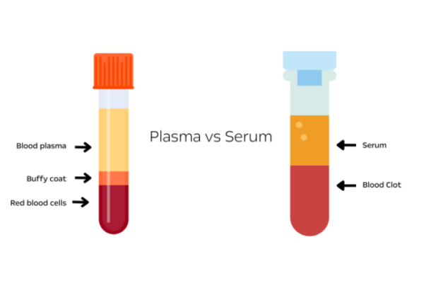
Why is Normal Saline 154?

Slide 8
Normal Sodium
A normal sodium concentration depends on what volume is considered.
Sodium concentration in plasma = 140 mEq/L
However, the majority of sodium is in the liquid aqueous phase of plasma.
Sodium concentration in the aqueous phase of plasma = 140/0.93 = 150.5 mEq/L

Slide 9
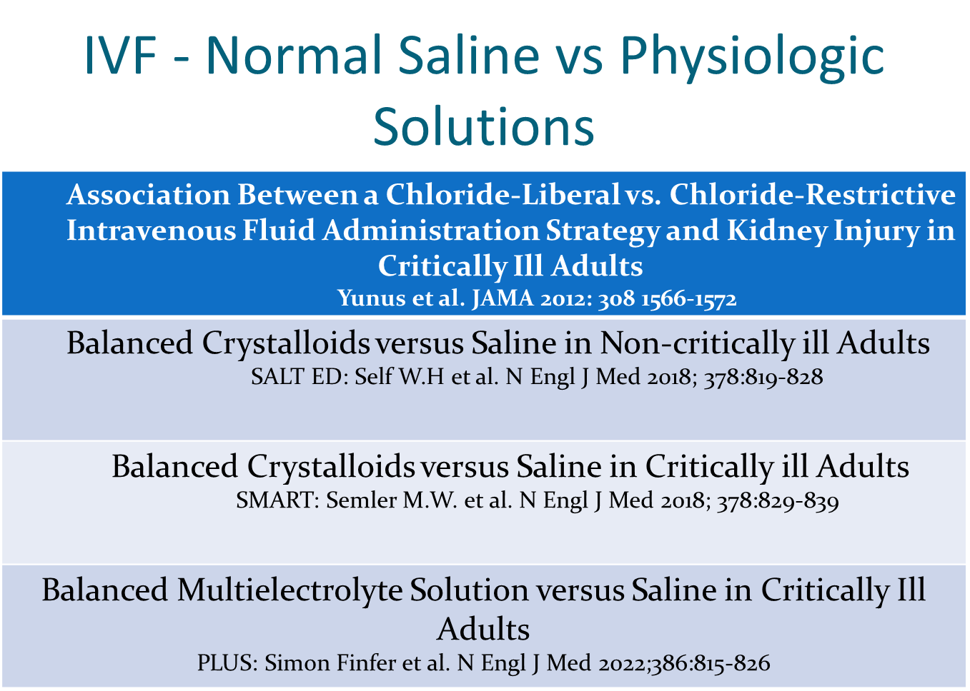

Slide 10
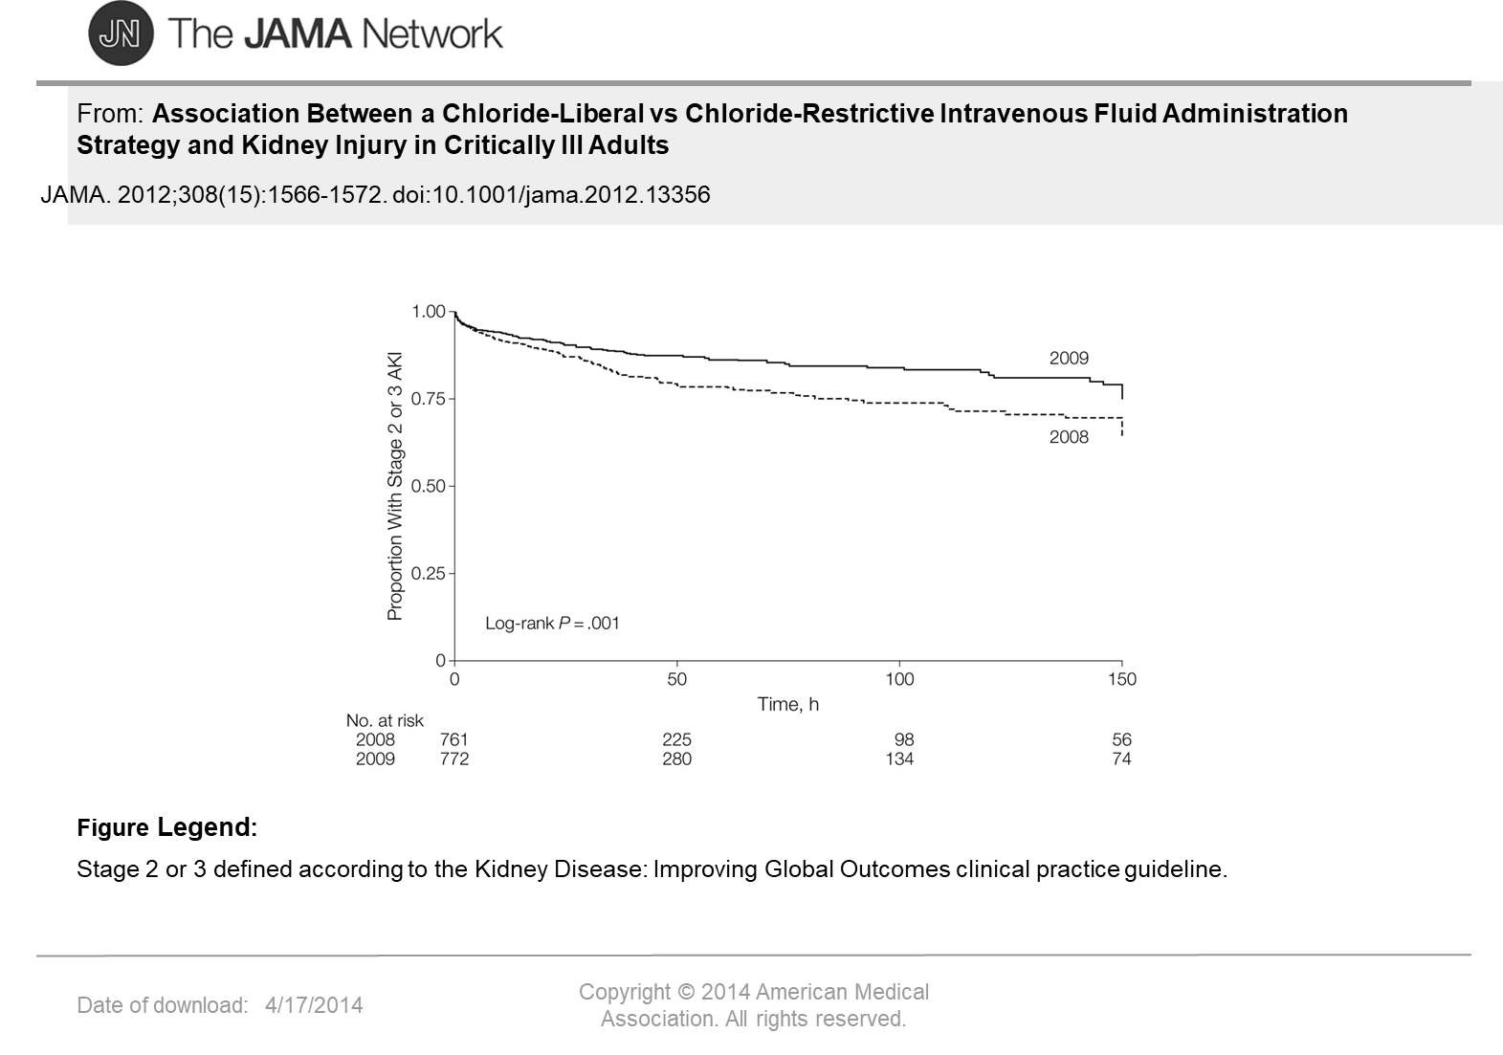

Slide 11
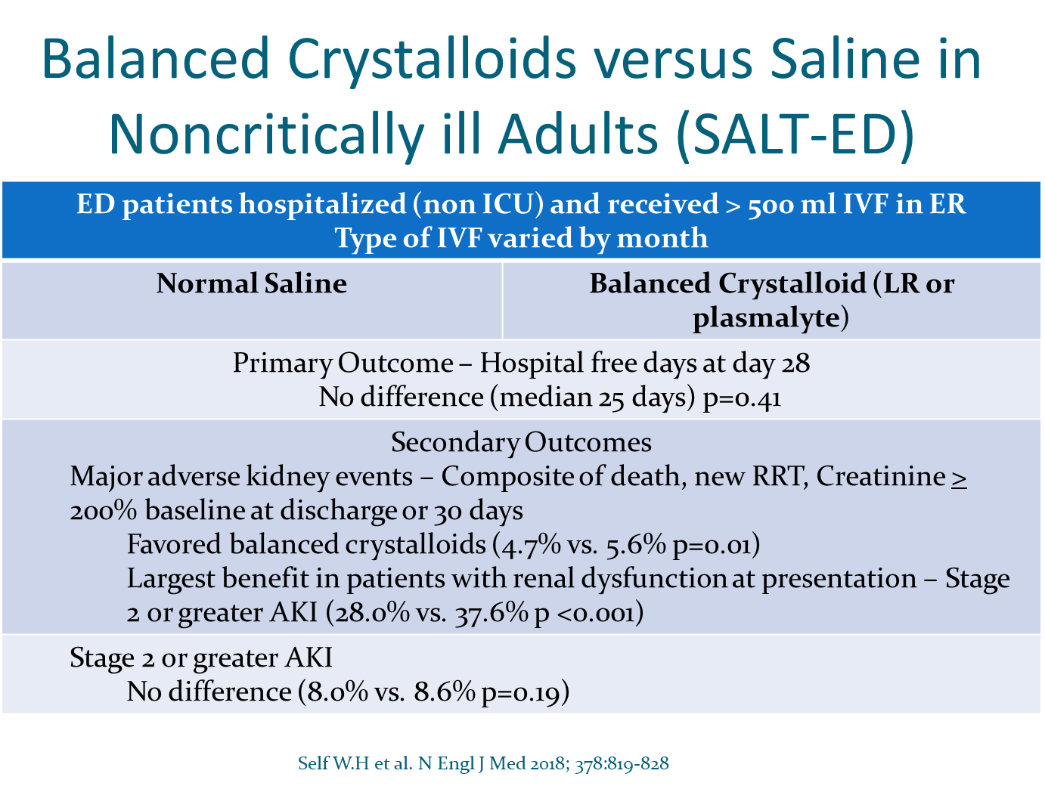

Slide 12
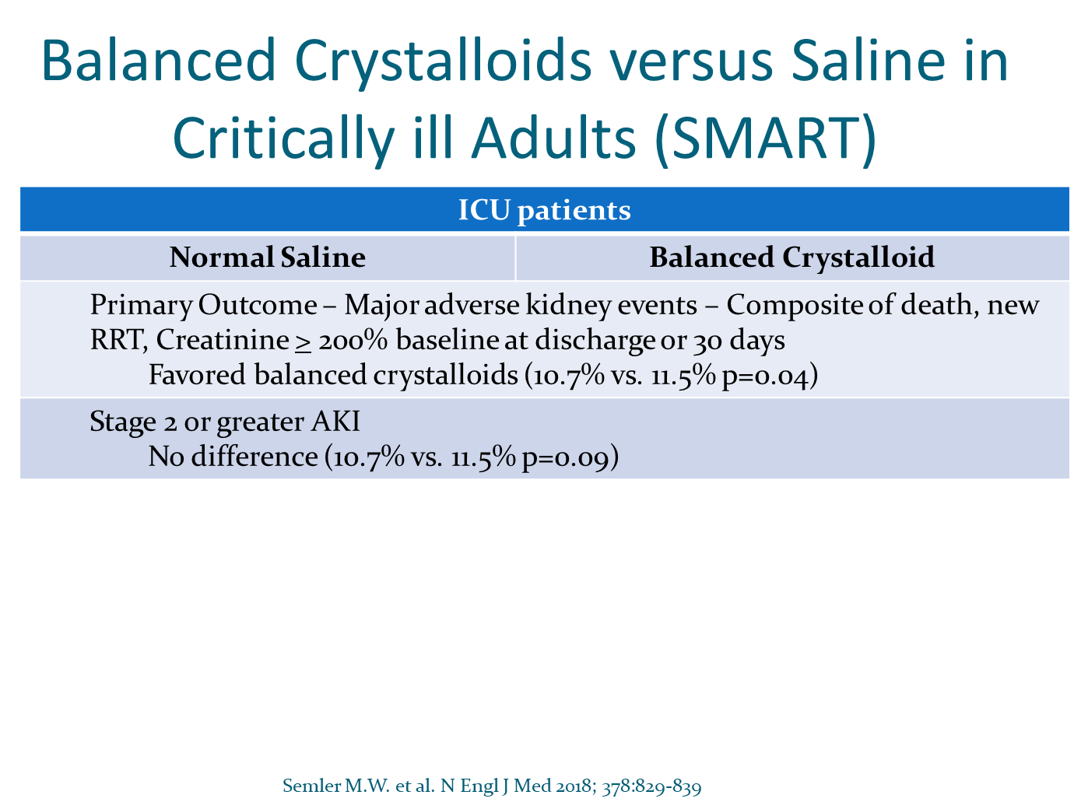

Slide 13
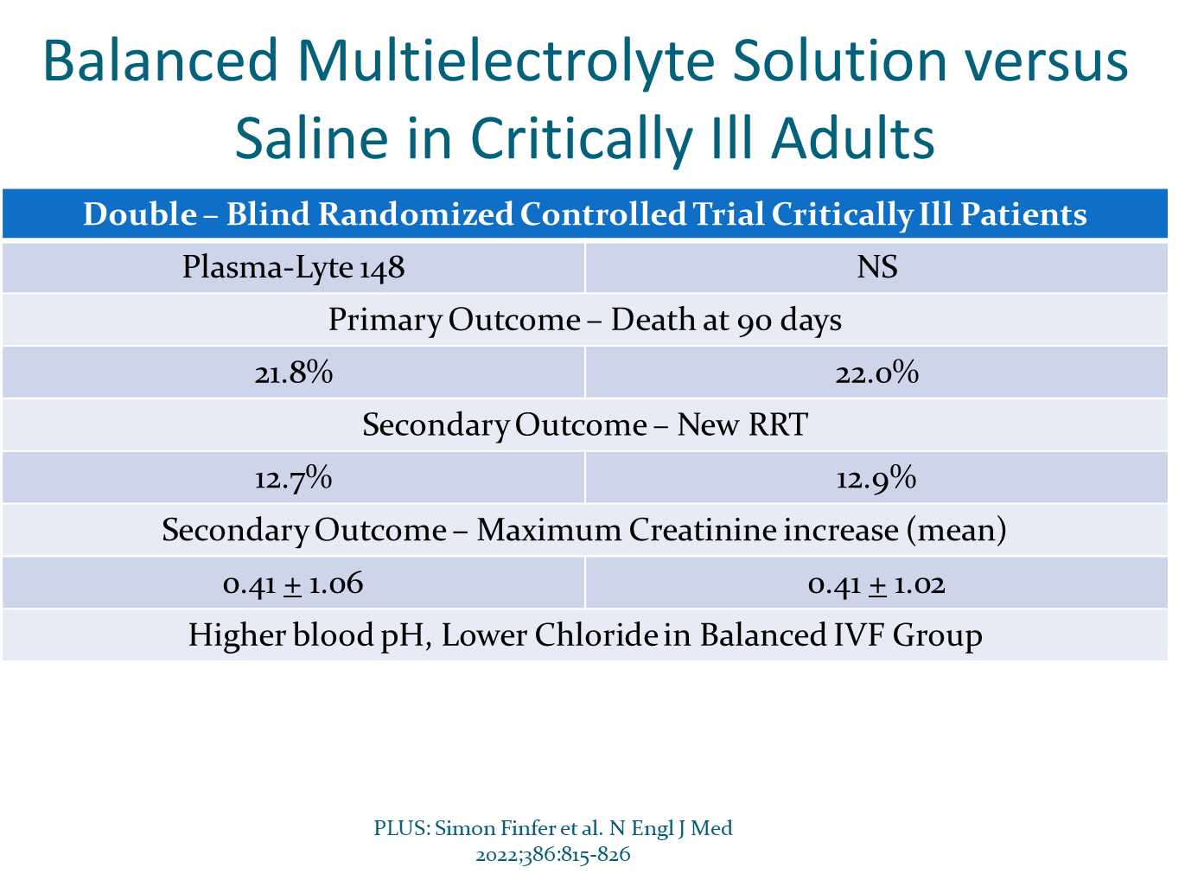

Slide 14
Case 2
58 year old woman with history of ischemic colitis 2 weeks s/p colectomy and ileostomy. Presents to ER with weakness and feeling “dehydrated”. Has had high ostomy output.
PMH: HTN, hyperlipidemia
Medications: Lisinopril, rosuvastatin, aspirin
PE: BP 88/54 HR 112, ill appearing. No edema
Labs: Na 134, K 5.2, Cl 114, CO2 10, BUN 52, Cr 1.8
Urine Na < 20, Cr 88
What IVF do you prescribe?

Slide 15
Case 2
58 year old woman with history of ischemic colitis 2 weeks s/p colectomy and ileostomy. Presents to ER with weakness and feeling “dehydrated”. Has had high ostomy output.
PMH: HTN, hyperlipidemia
Medications: Lisinopril, rosuvastatin, aspirin
PE: BP 88/54 HR 112, ill appearing. No edema
Labs: Na 134, K 5.2, Cl 114, CO2 10, BUN 52, Cr 1.8
Urine Na < 20, Cr 88
What IVF do you prescribe? Isotonic with Bicarbonate

Slide 16
IV Bicarbonate
Make HCO3 gtt isotonic. Isotonic = 154 meq/L; ½ NS = 77 meq /Liter
Each (amp) of HCO3 contains 50 meq Na
½ NS + 75 meq NaHCO3/liter or
D5W with 150 meq NaHCO3/liter

Slide 17
Framework for When to Give Bicarbonate
One can learn the specific guidelines for each condition. However, an understanding of the pathophysiologic cause of the acidosis is a useful determinant.
If the metabolic acidosis is caused by acid generation (organic acidosis), HCO₃– administration is reserved for severe life threatening acidosis.
If the metabolic acidosis is caused by HCO₃– loss from the body (or lack of HCO₃– generation by the kidney), the acidosis should be corrected with HCO₃– (or an alkali equivalent).

Slide 18
Case 3
68 year old male with history of atrial fibrillation, HTN and alcohol use disorder hospitalized with confusion and falls. Found to have SDH. S/p surgical evacuation. NPO pending speech and swallow evaluation
Meds include IV Decadron
PE: BP 142/76 HR 84 dry mucous membranes. No edema.
Na 156, K 3.6, BUN 52, Cr 1.3, glucose 321
Neurosurgical service states not to give Dextrose containing IVF
What can you do?

Slide 19
Case 3
68 year old male with history of atrial fibrillation, HTN and alcohol use disorder hospitalized with confusion and falls. Found to have SDH. S/p surgical evacuation. NPO pending speech and swallow evaluation
Meds include IV Decadron
PE: BP 142/76 HR 84 dry mucous membranes. No edema.
Na 156, K 3.6, BUN 52, Cr 1.3, glucose 321
Neurosurgical service states not to give Dextrose containing IVF
What can you do? Hypotonic without Dextrose (1/2NS)

Slide 20
Hypotonic IVF
½ NS = 50% saline and 50% water
Give ½ NS at double the intended rate of D5W will provide and equivalent amount of free water

Slide 21
Case 4
70 yo male with with BPH, dementia, metastatic lung cancer admitted with 2 weeks of nausea, poor oral intake and worsening lethargy.
PE: BP 102/64 HR 108. Cachectic, with slowed responses, dry oral mucosa, no respiratory distress or edema
Na 163, BUN 150, Cr 2.1, Ur Na < 20, Ur osm 835
Given 1 Liter NS. Post fluids BP 118/68, HR 98, Na 165, K 3.3, BUN 132 Cr 1.8
IVF changed to ½ NS at 80 ml/ hr and KCL 40 meq IV rider given. Following morning Na 164, K 3.6, BUN 114, Cr 1.6
What fluids do you give?

Slide 22
Case 4
70 yo male with with BPH, dementia, metastatic lung cancer admitted with 2 weeks of nausea, poor oral intake and worsening lethargy.
PE: BP 102/64 HR 108. Cachectic, with slowed responses, dry oral mucosa, no respiratory distress or edema
Na 163, BUN 150, Cr 2.1, Ur Na < 20, Ur osm 835
Given 1 Liter NS. Post fluids BP 118/68, HR 98, Na 165, K 3.3, BUN 132 Cr 1.8
IVF changed to ½ NS at 80 ml/ hr and KCL 40 meq IV rider given. Following morning Na 164, K 3.6, BUN 114, Cr 1.6
What fluids do you give? D5W

Slide 23
Hypotonic IVF
Reasons Hypernatremia may not correct
Osmotic diuresis
  Azotemia, resolving AKI
  Catabolic state (critically ill, corticosteroids, TPN)
K⁺ contributes to tonicity
  K exchanges for intracellular Na
  ½ NS + 40 meq KCl/L ≈ ¾ NS (77 + 40 = 112)
What do you do? D5W

Slide 24
Diuretics
Loop:
Furosemide
Bumetanide
Torsemide
Ethacrynic Acid
Thiazide:
HCTZ
Indapamide
Chlorthalidone
Metolazone
Chlorothiazide
Potassium sparing:
Triamterene
Amiloride
Mineralocorticoid Antagonist:
Spironolactone
Eplerenone
Finerenone
Carbonic anhydrase inhibitors:
Acetazolamide

Slide 25
Case 5
61 yo female with type 2 DM, HTN, CKD; HFrEF (40%) and MI presents with dyspnea and weight increase 3 kg over past week.
Meds: Metoprolol, lisinopril, insulin
PE: 155/78, hr 89 rr 25 88% on RA
Mild distress, bibasilar crackles, S3 gallop 2+ pitting edema
K 5.2, Co2 22, Cr 3.5 (b/l 2.0), mg 1.7
Ur Na < 20 Cr 98
Which Diuretic?

Slide 26
Case 5
61 yo female with type 2 DM, HTN, CKD; HFrEF (40%) and MI presents with dyspnea and weight increase 3 kg over past week.
Meds: Metoprolol, lisinopril, insulin
PE: 155/78, hr 89 rr 25 88% on RA
Mild distress, bibasilar crackles, S3 gallop 2+ pitting edema
K 5.2, Co2 22, Cr 3.5 (b/l 2.0), mg 1.7
Ur Na < 20 Cr 98
Which Diuretic? Loop

Slide 27
Loop Diuretic
Loop Thick Ascending Limb
Blocks NKCC channel
Thick ascending limb Loop of Henle
Can lead to excretion of 20-25% filtered Na⁺
Impairs both urinary dilution and concentration
Blood
Peritubular capillary
Na⁺ K⁺ ATPase
2K⁺
3Na⁺
Cl⁻
K⁺
NKCC
Ca²⁺
Na⁺
K⁺
2Cl⁻
ROMK
Urine
Tubular Lumen

Slide 28
Loop Diuretic
Uses
Edematous states
Hyponatremia (hypervolemic or euvolemic - SIADH)
HTN
Hyperkalemia
Hypercalciuria
Adverse effects
Hypokalemia
Metabolic alkalosis
Ototoxicity
Hypercalciuria
Contain sulfa (except ethacrynic acid)

Slide 29
Case 6
48 yo male referred for “resistant” HTN. Home and office BP readings range from 145-165/ 86-94 despite treatment with amlodipine, metoprolol and valsartan.
PMH: HTN, hyperlipidemia
PE: BP 154/88; HR 72 otherwise unremarkable, including neg edema
Labs: BMP wnl; UA negative
What medication do you add?

Slide 30
Case 6
48 yo male referred for “resistant” HTN. Home and office BP readings range from 145-165/ 86-94 despite treatment with amlodipine, metoprolol and valsartan.
PMH: HTN, hyperlipidemia
PE: BP 154/88; HR 72 otherwise unremarkable, including neg edema
Labs: BMP wnl; UA negative
What medication do you add? Thiazide

Slide 31
Thiazide diuretic
Distal Convoluted Tubule
Blocks Na Cl cotransporter
Distal convoluted tubule
Inhibits reabsorption of 3-5% of filtered Na
Impair urinary dilution (cortex)
Increases calcium resorption
Blood
Peritubular capillary
3Na⁺
Na⁺ K⁺ ATPase
2K⁺
3Na⁺
Cl⁻
Ca⁺⁺
a⁺⁺
TRPV5
NCC
Na⁺
Cl⁻
Ca⁺⁺
Urine
Tubular Lumen

Slide 32
Thiazide diuretic
Uses
HTN
Add on for edematous states
Nephrolithiasis (Hypercalciuria)
Nephrogenic Diabetes Insipidus
Adverse Effects
Hypokalemia
Metabolic Alkalosis
Hyponatremia
Hyperuricemia
Hyperglycemia
Contains Sulfa

Slide 33
Case 7
77 yo male admitted to cardiac ICU for acute exacerbation of CHF.
PMH: Cardiomyopathy EF 35%; Type 2 DM; HTN; depression
Meds: Insulin; amlodipine; bumetanide; lisinopril; carvedilol
PE: BP 138/84, HR 84, + JVD, bilateral crackles, S3 gallop, 2+ pitting edema
Labs: Na 142, K 3.9, CO2 28, BUN 29, Cr 1.8, BNP 800
Treated with IV bumetanide

Slide 34
Case 7 (cont)
3 days later. Clinically improved with increased urine output and improved dyspnea.
Na 140, K 3.1, CO2 38, BUN 8, Cr 0.6, Mg 1.5, BNP 450
pH 7.50, pCO2 50, pO2 88
What do you do next?

Slide 35
Case 7 (cont)
3 days later. Clinically improved with increased urine output and improved dyspnea.
Na 140, K 3.1, CO2 38, BUN 8, Cr 0.6, Mg 1.5, BNP 450
pH 7.50, pCO2 50, pO2 88
What do you do next? Mineralocorticoid Antagonist

Slide 36
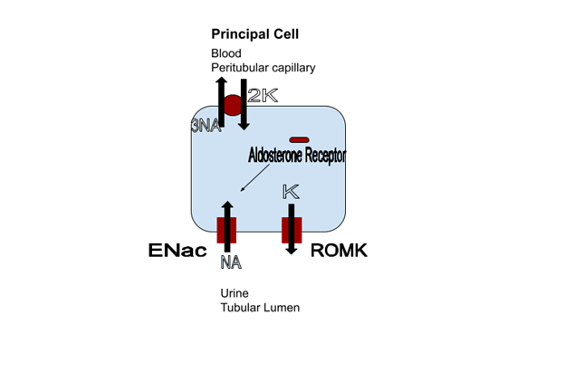
Mineralocorticoid Antagonists
Blocks Mineralocorticoid Receptor
Aldosterone Sensitive Distal Nephron
(Connecting Tubule and Collecting Duct)
Excretion of 1-2% of filtered Na⁺

Slide 37
Mineralocorticoid Antagonists
Uses
Hyperaldosteronism
Resistant HTN
Heart Failure
Hypokalemia
Proteinuria
Adverse effects
Hyperkalemia
Gynecomastia

Slide 38
Case 8
52 yo female with recurrent nephrolithiasis. Evaluation shows medullary sponge kidney with hypercalciuria. 24 hour urine calcium 310 mg
Treatment initiated with thiazide diuretic.
Follow up 24 hour urine calcium improved to 160 mg
Potassium 3.2.
What are your options?

Slide 39
Case 7 (redo)
3 days later. Clinically improved with increased urine output and improved dyspnea.
Na 140, K 4.2, CO2 46, BUN 8, Cr 0.6, Mg 1.5, BNP 450
pH 7.57, pCO2 52, pO2 88
What do you do next?

Slide 40
Case 7 (redo)
3 days later. Clinically improved with increased urine output and improved dyspnea.
Na 140, K 4.2, CO2 46, BUN 8, Cr 0.6, Mg 1.5, BNP 450
pH 7.57, pCO2 52, pO2 88
What do you do next? Carbonic anhydrase inhibitor

Slide 41
Carbonic Anhydrase Inhibitor
Uses
Metabolic Alkalosis (edematous)
Add on for CHF
Glaucoma
Altitude sickness
Adverse effects
Hypokalemia
Metabolic Acidosis
Calcium Phosphate Nephrolithiasis (Topiramate)

Slide 42
Carbonic Anhydrase Inhibitor
Proximal Convoluted Tubule
Blocks Carbonic Anhydrase
Proximal Convoluted Tubule
CA allows conversion of to H₂CO3⁻ to H₂0 + CO₂
60 - 65 % Filtered Na⁺ reabsorbed
Modest diuretic effect (majority of non reabsorbed
Fluid reabsorbed by loop of henle)
Blood: Peritubular capillary
Na⁺ K⁺ ATPase
2K⁺
3Na⁺
HCO3⁻
H₂0
+
CO₂
+
H₂CO3⁻
H⁺
Base⁻
NHE3
Na⁺
Cl⁻
H₂0
+
CO₂
H₂0 + H⁺
H₂CO3⁻
Urine: Tubular Lumen

Slide 43
Case 8
52 yo female with recurrent nephrolithiasis. Evaluation shows medullary sponge kidney with hypercalciuria. 24 hour urine calcium 310 mg
Treatment initiated with thiazide diuretic.
Follow up 24 hour urine calcium improved to 160 mg
Potassium 3.2.
What are your options? Potassium sparing (amiloride)

Slide 44
Potassium Sparing Diuretic
Blocks ENaC channel
Aldosterone Sensitive Distal Nephron
(Connecting Tubule and Collecting Duct)
Excretion of 1-2% of filtered Na⁺

Slide 45
Potassium Sparing Diuretic
Uses
Hypokalemia
Hypomagnesemia
Lithium Induced Nephrogenic Diabetes Insipidus
Adverse effects
Triamterene
  Associated with drug induced stones
Amiloride

Slide 46


Questions?
BC Nephro
bcnephro.com
Brian Cronin - YouTube
instagram.com/bcnephro/?hl=en

