Slide 1
Glomerular Diseases
Brian Cronin, MD, FASN, FACP
March 5 2024

Slide 2
Disclosure:
Several questions modified from ASN
Nephrology Quiz and Questionnaire
KSAP

Slide 3
Clinical Presentations of Glomerular Disease
Asymptomatic Proteinuria
Nephrotic Syndrome
Asymptomatic Hematuria
Progressive CKD
Acute Kidney Injury (RPGN)

Slide 4
Case 1
19 yo woman with no PMH referred for proteinuria found on UA at routine gynecology appointment. No associated symptoms, no edema, hematuria or foamy urine. Consumes a vegan diet. BP 110/70 exam no edema and otherwise unremarkable.
UA: SG 1.008, pH 8.2, leukocyte negative, nitrites negative, blood negative, protein 2+, glucose negative, ketones negative
How do you evaluate?

Slide 5
Urine Albumin Creatinine Ratio (UACR)
12 mg/gram
Urine Protein Creatinine Ratio (UPCR)
Urinalysis:
Checks for albumin
False Positive: Alkaline Urine (pH > 8.0), Concentrated Urine (High SG > 1.025), IV contrast, chlorhexidine
False Negative: Acidic pH, Dilute Urine (Low SG), Non albumin protein

Slide 6
Albumin, Microalbumin, Protein – What’s the difference?
Most urinary protein is albumin
In glomerular diseases urinary albumin is 55-60% of the total urinary protein
If the percentage is low (urinary albumin < 40% of the total urinary protein) think tubulointerstitial disease
If the percentage is very low (urinary albumin < 20% of the total urinary protein) think Bence Jones proteinuria (myeloma)

Slide 7
How do we classify the severity of proteinuria?
Microalbuminuria
  Albumin Creatinine ratio: 30- 300 microgram/ mg (or milligram/gram its the same thing)
  Equivalent protein creatinine ratio: 150 – 500 milligram/gram
Overt Proteinuria
  Albumin Creatinine ratio: > 300 microgram/ mg (or milligram/gram its the same thing)
  Equivalent protein creatinine ratio: > 500 milligram/gram
Nephrotic Range Proteinuria
  More than 3.5 grams / 24 hrs
  Protein Creatinine ratio > 3500 mg/g, Albumin creatinine ratio >2200 mcg/mg.
  This is an assumption.

Slide 8
Ratio or 24 Hour Urine?
Nephrotic proteinuria is more than 3.5 grams per 24 hours, but all I see are protein creatinine ratios and they ran out of those orange jugs. Help!
Assumption: If the patient peed in the jug for 24 hours there would be 1 gram of creatinine.
The protein creatinine ratio is reported in milligrams per gram. Using this assumption the ratio (number of milligrams per gram), roughly equals the mg of protein there would be if the patient did a 24 hour urine.
This assumption is not true because the amount of creatinine in a 24 hour urine depends on muscle mass (an elderly woman may have less 1 gram and a younger muscular man will have more).
We use this assumption anyway to rate the severity of proteinuria.

Slide 9
Case 2
68 year old woman noticed bilateral lower extremity edema one month ago. No other symptoms (no fever, anorexia, weight loss, night sweats, rash, joint pain or change in urine color).
Medications: Fish oil, acetaminophen.
Exam: Normal BP, 1+ pitting edema bilateral lower extremities
Creatinine 0.7 g/dl
Urinalysis 3+ protein, negative blood
Renal US: Unremarkable including negative for renal vein thrombosis
How do you evaluate?

Slide 10
Albumin 2.6 g/dl
Total Cholesterol 350 mg/dl
24 hour urine protein 10 grams/ day

Slide 11
Nephrotic Syndrome
The differential for nephrotic proteinuria may seem overwhelming, but it is manageable if you can remember 7 (five + two) things:
Five primary glomerular pathologies:
Minimal Change Disease (MCD)
Focal Segmental Glomerulosclerosis (FSGS)
Membranous Nephropathy (MN)
IgA Nephropathy
Membranoproliferative Glomerulonephritis (MPGN)
Two systemic diseases:
Diabetes
Amyloidosis

Slide 12
Minimal Change Disease
Occurs in young people. Most common cause of nephrotic syndrome in children. For this reason, children with nephrotic syndrome often don’t get a kidney biopsy. They assume this is the diagnosis and only biopsy if they don’t respond to treatment.
Can happen in adults too. About 10% of minimal change disease is in adults. Usually relatively young adults (average age 45).
Abrupt onset (days - weeks) of full blown nephrotic syndrome. That is edema, hypoalbuminemia and severe proteinuria. The proteinuria and hypoalbuminemia are relatively severe (i.e. 10 grams protein and albumin < 2.5 g/dl).
There can be associated AKI (in 25-35% of cases). This is not a nephritic or Rapidly Progressive Glomerulonephritis (RPGN). It is Acute Tubular Necrosis (ATN). This is attributed to a hypooncotic state with low blood pressure and renal edema.
Often steroid responsive with rapid, abrupt clinical response

Slide 13
FSGS
Primary idiopathic FSGS – A circulating permeability factor causes damage to the podocytes.
Secondary FSGS – A virus, toxin, or sheer stress causes damage to the podocytes.
Genetic FSGS
Residual scarring from prior inflammatory glomerular disease

Slide 14
Membranous Nephropathy
Often presents as full blown nephrotic syndrome with severe proteinuria with hypoalbuminemia and edema
Can present with non nephrotic proteinuria.
Often has a preserved glomerular filtration rate (GFR) at presentation.
Can result in chronic kidney disease (CKD), if the proteinuria is chronically severe
Rare cause of end stage kidney disease (ESRD).
Not an acute or rapidly progressive glomerulonephritis, but can be associated with acute kidney injury (AKI) via the mechanism of renal vein thrombosis.

Slide 15
Case 2 (cont)
ANA: negative
C3 and C4: within normal limits
Hepatitis B surface antigen: negative
Hepatitis C antibody: negative
SPEP/ UPEP: normal
ANCA panel: negative
Anything else?

Slide 16
Phospholipase A2 Receptor antibody
Positive in about 80% of cases of primary idiopathic membranous nephropathy.
High specificity (99%).

Slide 17
Renal Biopsy
 | Minimal Change Disease | FSGS | Membranous Nephropathy
LM | Normal | Segmental Hyalinosis and Sclerosis | Thickening of Basement Membrane Silver Stain: Characteristic Spike Pattern
IF | Negative | Nonspecific IgM and C3 | IgG and C3; PLA2R ab
EM | Diffuse Foot Process Effacement | Diffuse Foot Process Effacement | Subepithelial deposits

Slide 18
Case 3
32 year male found to have microscopic hematuria on life insurance physical. Notes dark urine when he has respiratory infections attributes to “dehydration”. No PMH or medications with the exception of occasional NSAIDS and protein powder. ROS otherwise negative including no edema.
PE: BP normal, unremarkable including no edema or rashes.
Creatinine 0.9 g/dl, UA: 2+ blood; negative protein; negative leukocyte 10-20 RBC/ hpf
CT urogram: normal
What’s your differential?

Slide 19
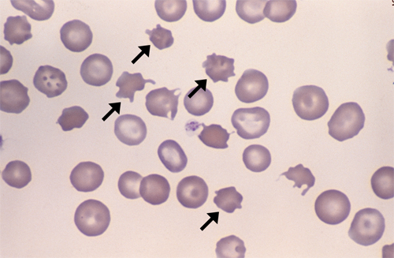

Slide 20
Hematuria Differential
Thin Basement Membrane Disease
  Benign Familial Hematuria
IgA Nephropathy
Alport Syndrome
  X - linked most common
C3 Nephropathy (MPGN)

Slide 21
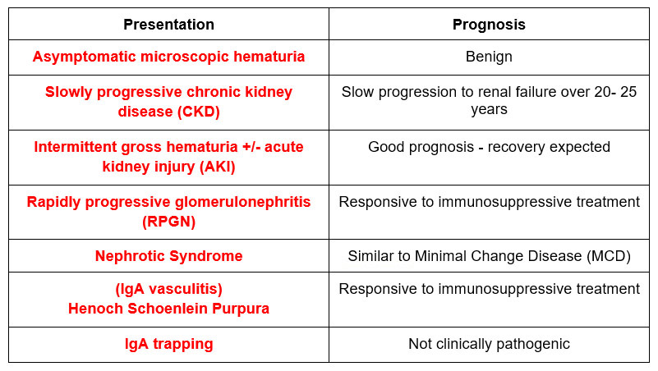
IgA Nephropathy - Clinical Presentations

Slide 22
IgA Nephropathy - Intermittent Gross Hematuria
Occurs in the context of an infection (an upper respiratory or gastrointestinal infection). Can present with AKI, even with crescents on kidney biopsy. But they get better. Recovery should occur within 1 week. Biopsy may show limited crescents (<25% of glomeruli). The differential includes:
Post infectious (post streptococcal) GN. The difference: In IgA nephropathy; the hematuria occurs at the time of the infection; it is referred to as synpharyngitic. In post infectious / post streptococcal hematuria will occur 1-2 weeks after the infection.
C3 Nephropathy/ Membranoproliferative GN (MPGN). The difference: in MPGN hematuria (or microhematuria) and low C3 will persist chronically
Post-infectious GN and MPGN are associated with low complements (C3 in post-infectious C3 and C4 in MPGN). IgA typically has normal serum complements.

Slide 23
MPGN
MPGN is not a specific disease, it is a pattern of injury seen on light microscopy of kidney biopsy.
Membrano – Diffuse thickening of glomerular capillary walls
Proliferative – Increased number of cells in the glomeruli
Therefore MPGN is when glomeruli have both thickened capillary walls and an increased number of cells
This is caused by immune complex deposition

Slide 24
MPGN
Pathophysiology of the immune complexes – Immunofluorescence
They can be caused by:
Immune complex deposition
Monoclonal immunoglobulin deposition
Dysregulation of the alternative complement pathway
These can be deduced by the pattern on immunofluorescence. Immunofluorescence can show:
Immunoglobulin (with or without complement)
Complement Dominant
Immunofluorescence Negative (There are also cases without immune complexes)

Slide 25
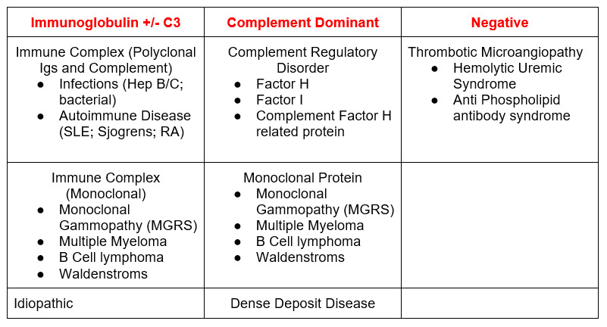
MPGN: Biopsy Immunofluorescence

Slide 26
Case 4
52 year old male referred for creatinine elevation 1.8 g/dl. Records show creatinine increase from 1.4 g/dl over past 5 years. PMH: HTN, OSA, hyperlipidemia, impaired fasting glucose. Medications: Losartan, amlodipine, rosuvastatin, fenofibrate, aspirin
PE: BP 152/88, BMI 36, negative for edema
Albumin 3.8 g/dl; UA: 3 + protein; neg blood; negative leukocyte
UACR: 3800 mg/g
Renal US: RK 12.6 LK 12.8 cm. Increased echogenicity
What’s the Diagnosis?

Slide 27
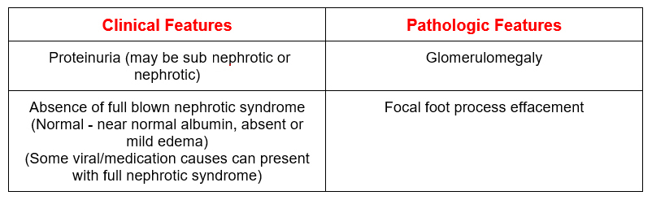
Adaptive/ Secondary FSGS

Slide 28
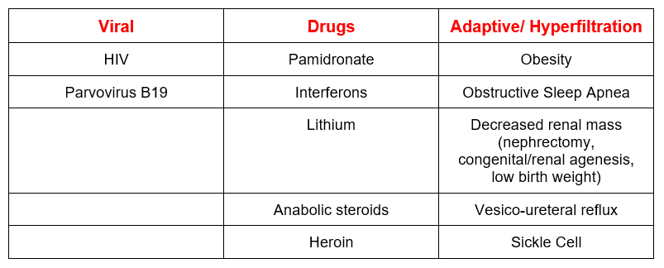
Adaptive/ Secondary FSGS: Causes

Slide 29
Case 5
83 year old male presents to PCP because he thinks he has the flu. 1 week of chills, poor appetite and malaise.
PE: Afebrile, BP 155/95, ill appearing, trace lower extremity edema
Creatinine 2.9 mg/dl (baseline 0.9 mg/dl 3 months ago)
Referred to ER
Creatinine 3.1 g/dl
Urinalysis: 3+ blood; 2+ protein
CXR: No infiltrates
What is the most likely diagnosis?

Slide 30
RPGN
When glomerular hematuria is present we are concerned about 3 potential pathophysiologic mechanisms present.
Antibodies against the glomerular basement membrane
  Anti GBM antibody disease (Goodpasture’s)
Immune complexes that deposit in the glomeruli causing inflammation
  Cryoglobulinemia
  IgA Nephropathy
  Lupus Nephritis
  Membranoproliferative Glomerulonephritis
  Post Streptococcal/Infectious GN
  PGNMID: Proliferative Glomerulonephritis with Monoclonal Immunoglobulin Deposits
Pauci Immune: ANCA associated
  Granulomatosis with polyangiitis (GPA) – C ANCA
  Microscopic polyarteritis (MPA) – P ANCA
  Churg Strauss syndrome

Slide 31
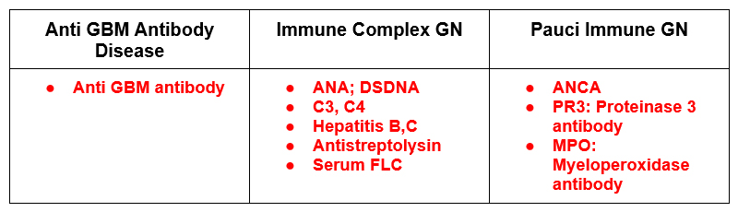
RPGN: Serologic Evaluation

Slide 32
Case 3 (cont)
ANCA:
MPO > 100
PR3 negative
Biopsy:
Light Microscopy: Necrotizing and crescentic GN
What’s the Diagnosis?

Slide 33
Biopsy: Immunofluorescence
Anti GBM antibody disease
  Linear staining with IgG and C3. This is because the antibody is against the basement membrane itself so the deposition is continuous.
Immune Complex
  Granular deposition. (Often IgG and C3). This is because the pathogenesis is antibody-antigen complexes that deposit in the glomerulus in a non continuous pattern.
ANCA associated (pauci-immune)
  Negative or minimally positive immunofluorescence, this is not associated with immune complex deposition and there is a paucity of staining

Slide 34

Questions?
BC Nephro
bcnephro.com
Instagram
instagram.com/bcnephro/?hl=en
Brian Cronin - YouTube

